Slide 1
Bienvenue à la classe de français!
M. Schott
ronaldschott@hvrsd.org
737-4004 Ext. 1191

Slide 2
La culture
français 6 À Paris | français 7 Québec Western France | français 8 Le Sénégal Le sud de la France

Slide 3
La culture
Introduction to français 7 Art Holidays |  | Introduction to français 8 Movies Music Sports

Slide 4
Les thèmes
français 6 Greetings Numbers Classroom Likes/Dislikes Leisure | français 7 Family School Sports Weather Food | français 8 Clothing Home Life In the City Vacationing

Slide 5
Les thèmes
Introduction to français 7 Greetings Numbers Classroom |  | Introduction to français 8 Verbs Likes/Dislikes Leisure

Slide 6
Listening/Speaking
Skills
Reading/Writing Skills
Students need to demonstrate proficiency
before moving to the next level.

Slide 7
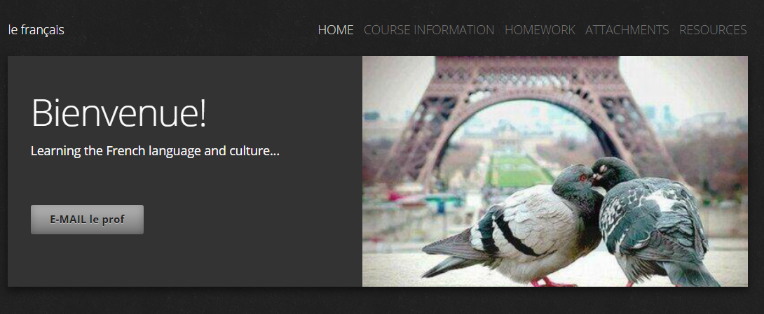
timberlanefrench.weebly.com

Slide 8
FLEX
LUNCH
Before/After School, if given some notice

Slide 9
How to communicate
ronaldschott@hvrsd.org
timberlanefrench.weebly.com
609-737-4004 Ext 1191

